Slide 1

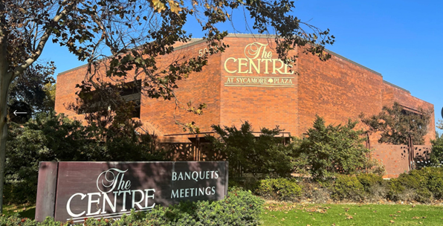

Boeing Leadership Association of Southern California
proudly presents:
June GMM: Tribute to our Past Leadership Award Winners
TUESDAY, JUNE 24, 2025
THE CENTRE
5000 Clark Ave, Lakewood, CA 90712
AGENDA
5:00 Check-in and Networking and wine tasting
6:00 Open Meeting and Invocation & Pledge
6:05 Dinner
7:00 Speaker
8:00 Adjournment
RESERVATIONS REQUIRED BY
Wednesday, June 18, 2025
www.blasc.us, EVENTS Your reservation commits BLASC to pay the facility for your dinner.
Cancel or change RSVP on the EVENTS page.
Please contact Imelda Hunkin for question regarding registration and Corine Kumano for questions about the event.
GUEST ARE WELCOME
Please RSVP for each person individually.
The cost for each guest is $45. Please contact Imelda Hunkin for question regarding registration.
No refunds for cancellations after 12:00 PM Friday, June 20th. Checks payable to BLASC and credit care payments will be collected the evening of the event at the check-in table.
RETIREES-$45
Contact Annie Fleury at: annie.fleury@boeing.com
Menu
ITALIAN CHOPPED SALAD
Herb Red Wine Balsamic Vinaigrette
CHICKEN BREAST PICATTA
Lemon, Capers, Wine Sauce
Mama Mia GRANDE MEATBALL MARINARA
Seasoned Beef & Pork w/House Made Marinara
BAKED MOSTACCIOLI PASTA
Tomatoes, Garlic, Ricotta, Mozzarella, Parmesan
BALSAMIC ROASTED VEGETABLES
DESSERT- Chef’s Choice
*GF and Vegetarian option available

