Slide 1
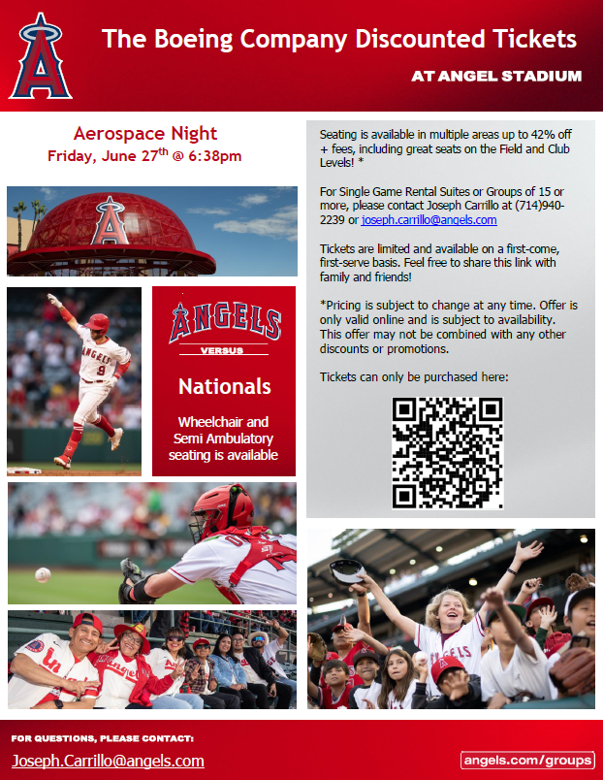
Southern California Aerospace at Angel Stadium
Website Link: https://www.gofevo.com/event/theboeingcompany2025
Who: All Boeing employees, family, friends, and guests are welcome!
BLASC and Boeing team members to meet under the Baseball Cap from 6pm to 6:30pm before the game for meet and greet. Don’t forget to wear you Boeing shirts! ☺
Please use the link above to purchase your tickets. ⭐
What: Angels Baseball is hosting Southern California Aerospace Night! All local Aerospace companies are invited - and for any companies with 100+ in attendance, we will be able to have a company representative down on the field during the pre-game. Show your Boeing pride & get your tickets now for a Friday night under the lights against the Washington Nationals!
Tickets range from $24 - $113 in the following sections:
Field MVP (sections 109 - 113)
Club MVP (sections 315 - 322)
Field All-Star (sections 106 - 108)
Field Box (sections 101 - 105)
When: Friday, 6/27/25 @ 6:30PM
Where: Angel Stadium - 2000 E Gene Autry Way, Anaheim CA, 92806
For Info, Contact:
Brian Metran
Brian.M.Metran@Boeing.com

