Slide 1
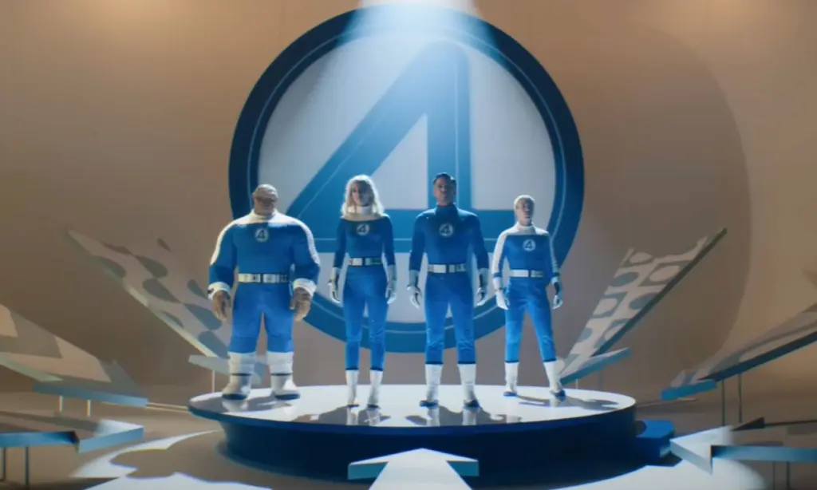

BLASC Movie Night, Tuesday, August 19, 2025
BLASC Movie Night – Fantastic Four
Tuesday, August 19, 2025
Check-In Time: 5:00 PM
Movie Time: 5:30 PM (no previews)
Seats are first come first serve
Cinemark Century Huntington Beach and XD
7777 Edinger Ave, Suite 170
Huntington Beach, CA 92647
Cost: BLASC Members- FREE
Guests $8 – Cash at the event
Contact
Brian Metran Brian.M.Metran@Boeing.com
for more details

