Slide 1

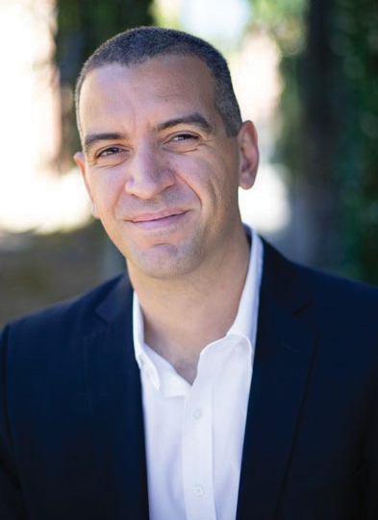
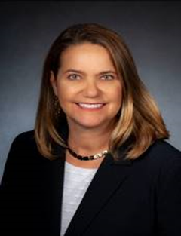
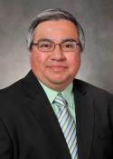
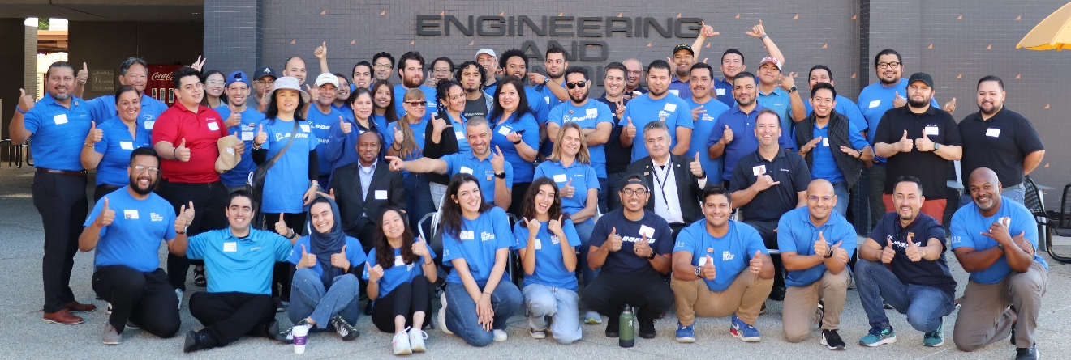
^{21st} Annual Cal State LA MESA STEM Day in Partnership with Boeing
What is it?
Cal State LA and Boeing will lead hands-on STEM workshops and technical demos for middle and high school students enrolled in the Mathematics, Engineering, Science Achievement (MESA) Program.
Date, Time & Location
Saturday, November 8, 2025
8:00 AM to 1:00 PM (PST)
Hosted by Cal State LA’s College of ECST. Located at
5151 State University Drive, Los Angeles, CA 90032
Volunteers Needed!!!
Recruiting Boeing professionals to support STEM activities with students. A virtual training will be scheduled in advance for all Boeing volunteers on October 23rd from 12pm-1pm PST
Leaders Participating:
Sergio Bustamante
Vice President
Boeing Global Services
Laurel Gutierrez
Senior Director
Defense, Space & Security
Al Pedroza
Senior Director
Boeing Test and Evaluation
**** Please click on the link below to sign-up!! ****
https://emc.web.boeing.com/home.aspx#!/semsummary/2676
  For more information, please contact:
  Seal Beach: Luis F. Castro / Alexis Rios
  El Segundo: Ernesto E. Covarrubias / Murat Piker
  Huntington Beach: Alexander Tascon
  Long Beach: Carlos Galvan / Maida Lopez
Copyright © 2025 Boeing. All rights reserved.

