Slide 1

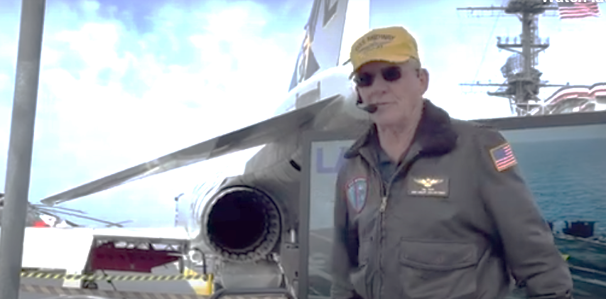
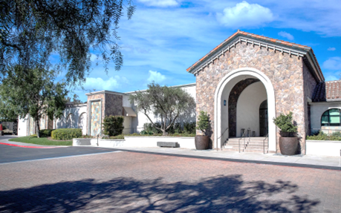
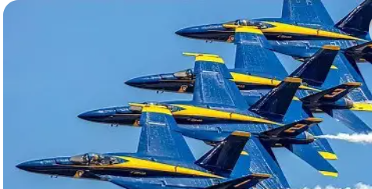
Boeing Leadership Association of Southern California
proudly presents:
Tuesday, February 24, 2026, GMM
Featuring: Gil Rud of the Blue Angles
Gil Rud's journey from rural North Dakota to the cockpit of the U.S. Navy Blue Angels is a testament to his dedication and skill as a pilot. His memoir, "From the Prairie to the Pacific: A Blue Angel's Journey," offers a glimpse into his life's adventures, from flying combat missions in Vietnam to commanding the Blue Angels and an aircraft carrier. Rud's experiences reflect his growth as a leader, his commitment to service, and his ability to overcome challenges with humility and resilience. His story is a reminder of the importance of discipline, legacy, and heart in achieving excellence and service to others.
Old Ranch Country Club
3901 Lampson Avenue, Seal Beach, CA, 90740
Hellcats to Super Hornets
RESERVATIONS REQUIRED BY
Friday, February 20, 2026
www.blasc.us, Your reservation
commits BLASC to pay the facility for your dinner.
Cancel or change RSVP on the EVENTS page.
Please contact Imelda Hunkin for question regarding registration and Jose Garcia for questions about the event.
GUEST ARE WELCOME
Please RSVP for each person individually
The cost for each guest is $45. Please contact question regarding registration.
No refunds for cancellations after 12:00 PM Friday, February 20th. Checks payable to BLASC will be collected the
evening of the event at the check-in table.
RETIREES-$40
Contact Annie Fleury at:
annie.fleury@boeing.com
AGENDA
5:00 Networking, with Wine Tasting
6:00 Open Meeting, Introduce New Board & Announcements
6:10 Invocation & Pledge
6:15 Dinner
7:00 Keynote Speaker
8:00 Adjournment
Menu
Dinner: Assorted Roles & Butter, Baby Fields Salad, Rosemary Roasted Chicken Breast, Chocolate Ganache Cake, Tea & Coffee station
Vegetarian and Gluten Free options available

